Slide 1


Fotis Tasioulis
06/12/2022

Slide 2
Outline
Executive Summary
Introduction
Methodology
Results
Conclusion
Appendix

Slide 3
Executive Summary
Summary of methodologies
Data Collection through API
Data Collection with Web Scraping
Data Wrangling
Exploratory Data Analysis with SQL
Exploratory Data Analysis with Data Visualization
Interactive Visual Analytics with Folium
Machine Learning Prediction
Summary of all results
Exploratory Data Analysis result
Interactive analytics in screenshots
Predictive Analytics result

Slide 4
Introduction
Project background and context
Space X advertises Falcon 9 rocket launches on its website with a cost of 62 million dollars - other providers cost upward of 165 million dollars each, much of the savings is because Space X can reuse the first stage. In this project, I will help my company Space Y which is a competitor to determine the price of each launch by gathering information and creating dashboards for my team. The target is to determine if Space X will re-use the first stage using a machine learning model and public information. This will help my company to bid against Space X for a rocket launch.
Problems you want to find answers
The interaction amongst various features that determine the success rate of a successful landing.
What factors determine if the rocket will land successfully?
What operating conditions need to be in place to ensure a successful landing program?

Slide 5

Section 1

Slide 6
Methodology
Executive Summary
Data collection methodology:
Data was collected using SpaceX API and web scraping from Wikipedia
Perform data wrangling
One-hot encoding was applied to categorical features
Perform exploratory data analysis (EDA) using visualization and SQL
Perform interactive visual analytics using Folium
Perform predictive analysis using classification models
How to build, tune, evaluate classification models

Slide 7
Data Collection
The data was collected using the following methods:
Used the get request to the SpaceX API.
Decoded the response content as a JSON using .json() function call and turned it into a pandas dataframe using .json_normalize().
Cleaned the data, checked for missing values, and filled missing values where required.
Performed web-scraping from Wikipedia for Falcon 9 launch records using BeautifulSoup.
The objective was to extract the launch records as an HTML table, parse the table and convert it to a pandas data frame for future analysis.

Slide 8
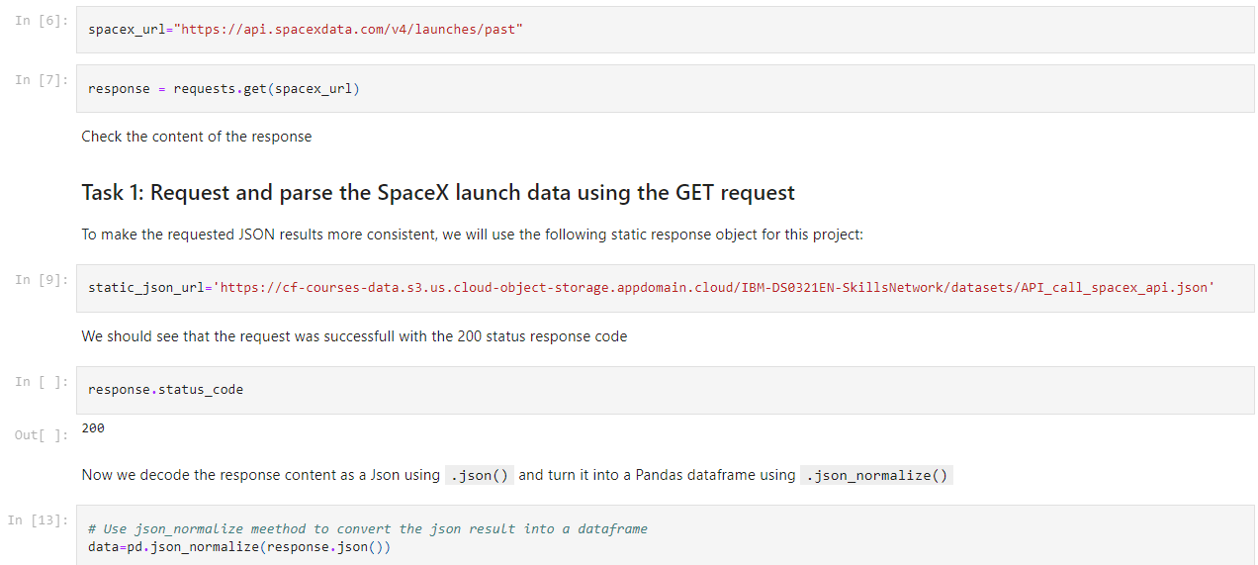
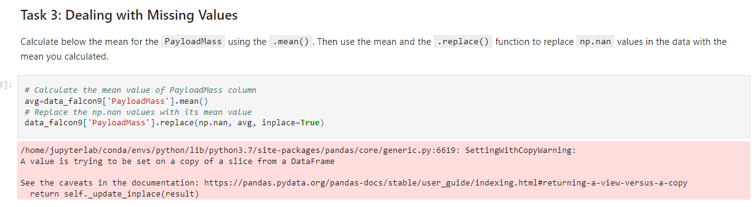
Data Collection – SpaceX API
Collection of data with the get request, data formatting and cleaning.
Notebook link: https://github.com/ftasioulis/Data-Science-Capstone-Project/blob/f4e94ce5eb9a681a4d8271f156e3f2d6f05b6ee9/SpaceX%20-%20Data%20Collection.ipynb.

Slide 9
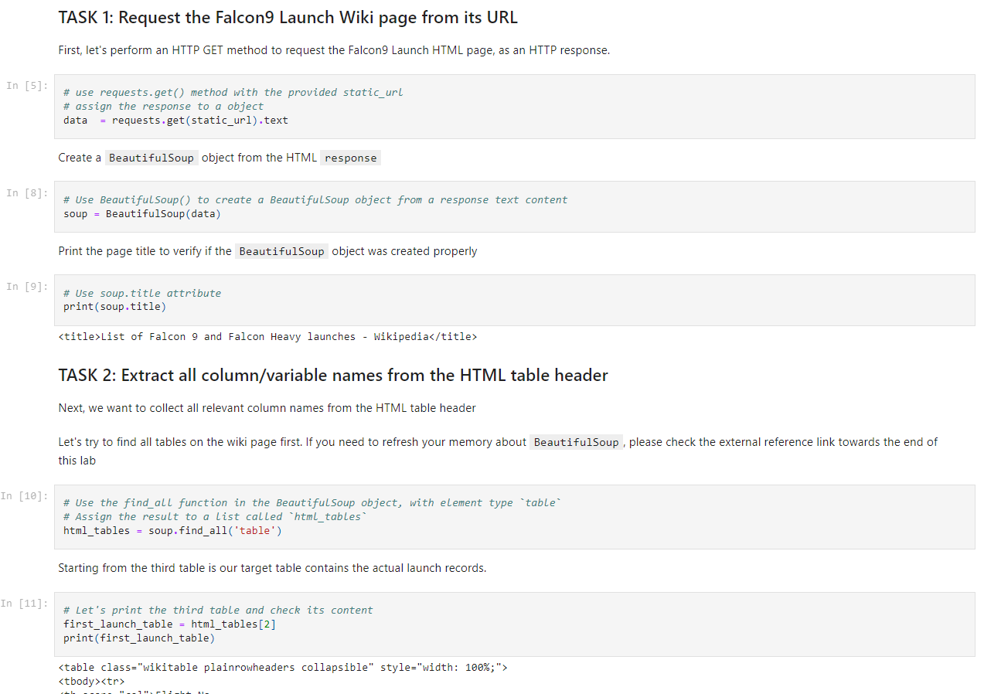
Data Collection - Scraping
Applied web scrapping to webscrap Falcon 9 launch records with BeautifulSoup.
Parsed the table and converted it to a pandas dataframe.
Notebook link: https://github.com/ftasioulis/Data-Science-Capstone-Project/blob/f4e94ce5eb9a681a4d8271f156e3f2d6f05b6ee9/SpaceX-webscraping.ipynb.

Slide 10
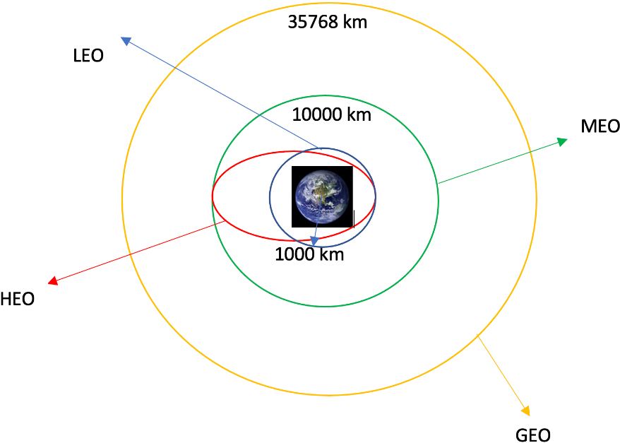
Data Wrangling
Performed exploratory data analysis and determined the training labels.
Calculated the number of launches at each site - number and occurrence of each orbit.
Created a landing outcome label from the Outcome column.
Notebook link: https://github.com/ftasioulis/Data-Science-Capstone-Project/blob/f4e94ce5eb9a681a4d8271f156e3f2d6f05b6ee9/SpaceX-Data%20wrangling.ipynb.

Slide 11
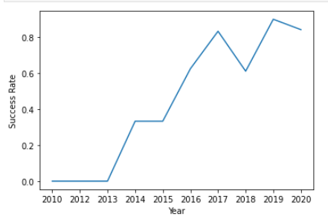
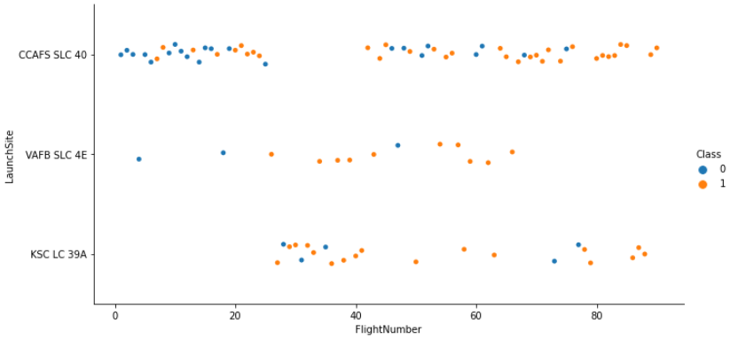
EDA with Data Visualization
Performed exploratory data analysis and feature engineering using Pandas and Matplotlib.
Visualized relationships between Flight Number, Launch Site, Payload, the success rate of each orbit type, and launch success yearly trend.
Notebook link: https://github.com/ftasioulis/Data-Science-Capstone-Project/blob/439136a95fe460e97393aec299ca073e9ad795e2/SpaceX-EDA%20Data%20Visualization.ipynb.

Slide 12
EDA with SQL
Loaded the SpaceX dataset into a PostgreSQL database.
Executed the following queries:
Displayed the names of the unique launch sites in the space mission.
Displayed 5 records where launch sites begin with the string ‘CCA’.
Displayed the total payload mass carried by boosters launched by NASA.
Displayed average payload mass carried by booster version F9 v1.1.
Listed the date when the first successful landing outcome in the ground pad was achieved.
Listed the names of the boosters which have success in drone ships and have payload mass greater than 4000 but less than 6000 kg.
Listed the total number of successful and failed mission outcomes.
Listed the names of the booster versions which have carried the maximum payload mass.
Listed the records which will display the month names, failures, booster versions, and launch sites for the months in year 2015.
Ranked the count of successful landing outcomes between the date 04-06-2010 and 20-03-2017 in descending order.
Notebook link: https://github.com/ftasioulis/Data-Science-Capstone-Project/blob/439136a95fe460e97393aec299ca073e9ad795e2/SpaceX%20EDA%20with%20SQL.ipynb.

Slide 13

Build an Interactive Map with Folium
Added map objects such as markers, circles, and lines.
Target was to find an optimal location for building a launch site by analyzing the data from the existing launch site locations.
Objectives were the following:
Mark all launch sites on the folium map.
Mark the success/failed launches for each site on the map.
Calculate the distances between a launch site to its proximities.
Notebook link: https://github.com/ftasioulis/Data-Science-Capstone-Project/blob/439136a95fe460e97393aec299ca073e9ad795e2/SpaceX-Launch%20Sites%20Locations%20Analysis%20with%20Folium.ipynb.

Slide 14
Predictive Analysis (Classification)
Created a machine learning model pipeline to predict if the first stage will land.
Loaded the data using NumPy and Pandas libraries, transformed the data, and split them into training and testing data to improve the accuracy of the models.
Used different machine learning models (SVM, Classification trees, and Logistic Regression) and tuned different hyperparameters.
Found which method performs better by considering accuracy.
Best model was the Decision Tree with an accuracy of approximately 89%.
Notebook link: https://github.com/ftasioulis/Data-Science-Capstone-Project/blob/0c6d6166af66883d484970fc7f97f834988f5e2f/SpaxeX-Predictive%20Analysis%20(Classification).ipynb.

Slide 15
Results
Exploratory data analysis results
Interactive analytics demo in screenshots
Predictive analysis results

Slide 16

Section 2

Slide 17
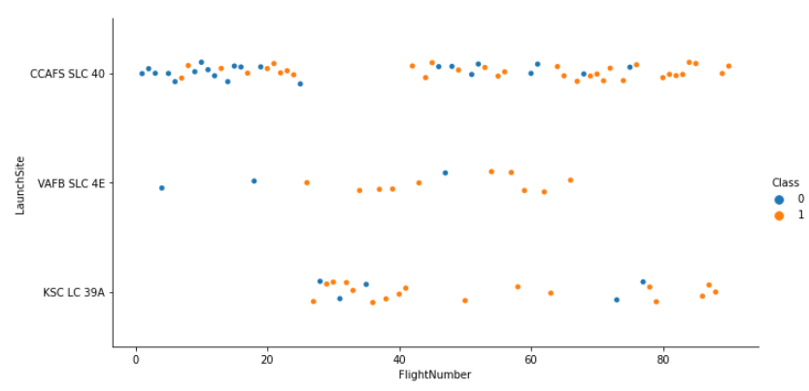
Flight Number vs. Launch Site
It can be noticed that as the flight number from a launch site increases the success rate from a launch site improves as well.

Slide 18
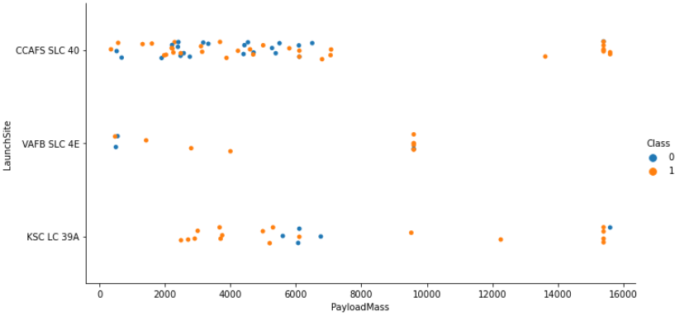
Payload vs. Launch Site
It can be noticed that for the VAFB-SLC launch site there are no rockets launched for heavy upload mass greater than 10000.

Slide 19
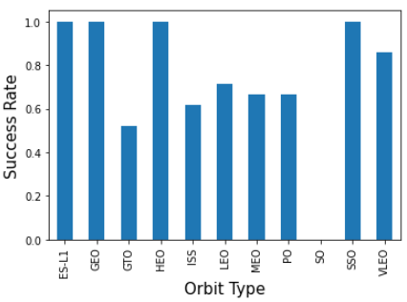
Success Rate vs. Orbit Type
It can be noticed that ES-L1, GFO, HEO, and SSO - Orbit Types have the best success rates.

Slide 20
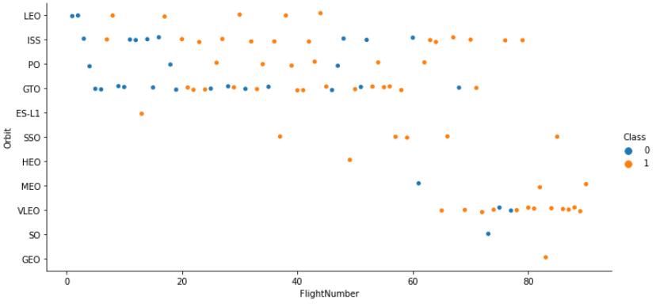
Flight Number vs. Orbit Type
It can be noticed that in LEO Orbit the success appears related to the number of flights whereas when in GTO orbit there seems to be no relationship between the flight number.

Slide 21
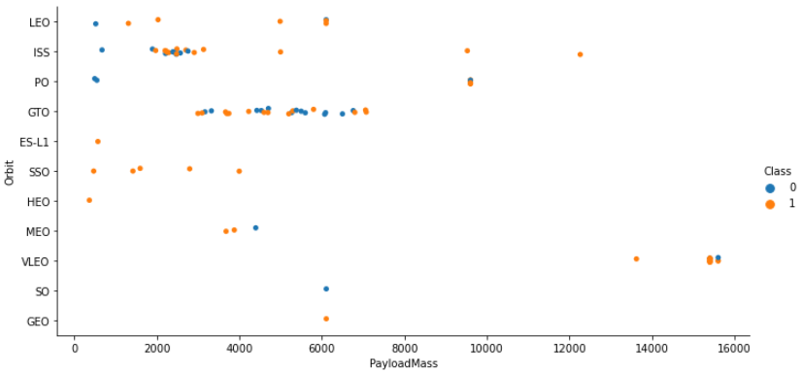
Payload vs. Orbit Type
It can be noticed that with heavy uploads the successful landing is more for POLAR, LEO, and ISS.
For GTO it cannot be distinguished well as positive and negative landing are both together.

Slide 22
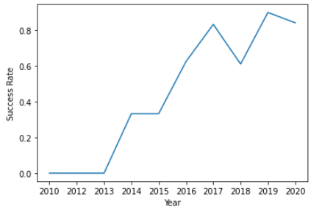
Launch Success Yearly Trend
It can be noticed that the success rate since 2013 kept on increasing till 2020.

Slide 23
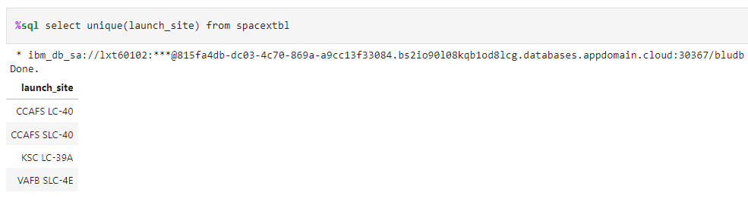
All Launch Site Names
Used the keyword unique to find the different launch sites from the Space X table.
Displayed the names of the unique launch sites in the space mission.

Slide 24
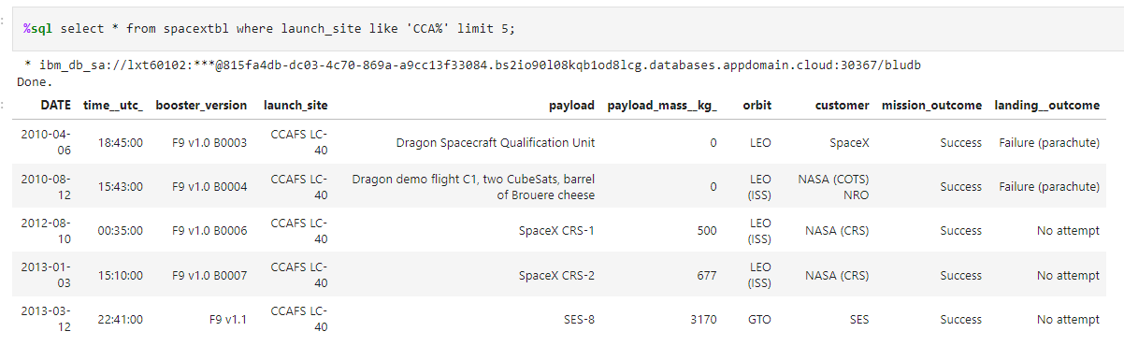
Launch Site Names Begin with 'CCA'
Used the query to display 5 records where launch sites begin with the string ‘CCA’.

Slide 25
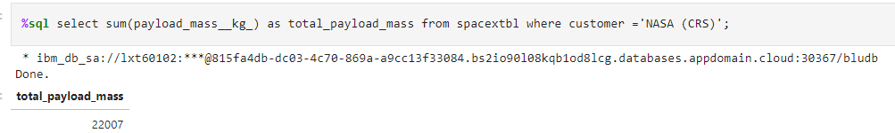
Total Payload Mass
Displayed the total payload mass carried by boosters launched by NASA (CRS).

Slide 26
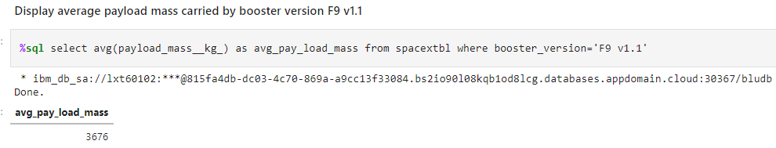
Average Payload Mass by F9 v1.1
Displayed the average payload mass carried by booster version F9 v1.1.

Slide 27
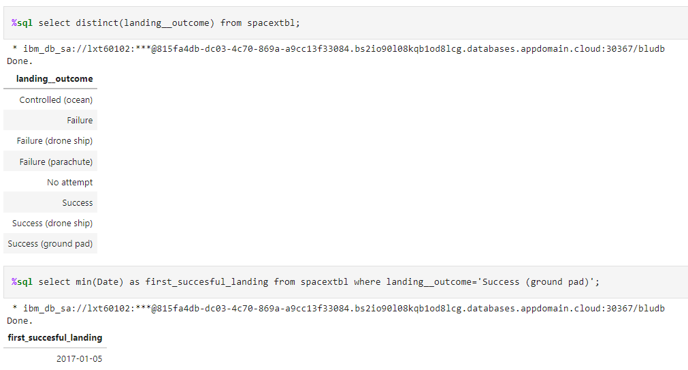
First Successful Ground Landing Date
Displayed the date when the first successful landing outcome on the ground pad was achieved.

Slide 28
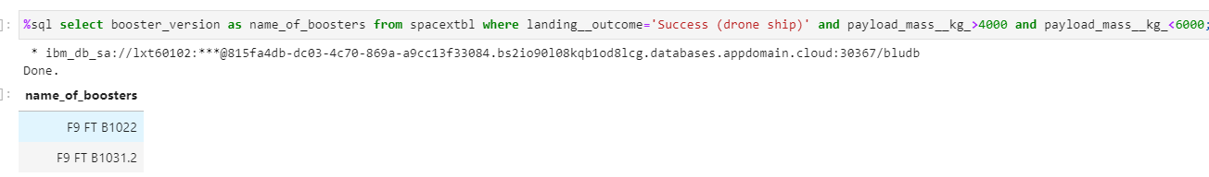
Successful Drone Ship Landing with Payload between 4000 and 6000
Displayed the names of the boosters which have success in drone ship and have payload mass greater than 4000 but less than 6000.

Slide 29
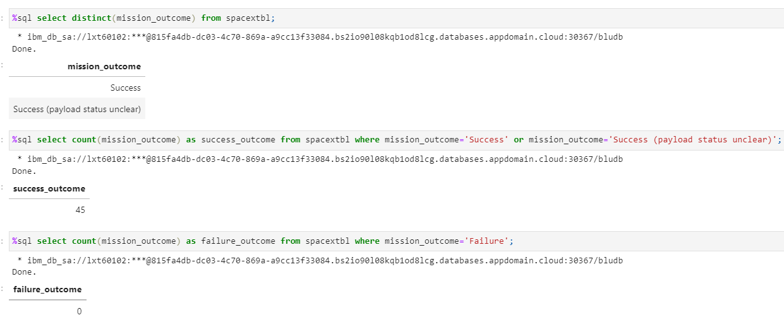
Total Number of Successful and Failure Mission Outcomes
Displayed the total number of successful and failed mission outcomes.

Slide 30
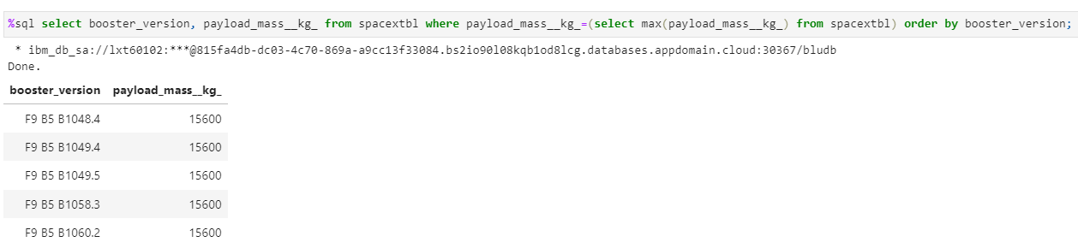
Boosters Carried Maximum Payload
Displayed the names of the booster versions which have carried the maximum payload mass.

Slide 31
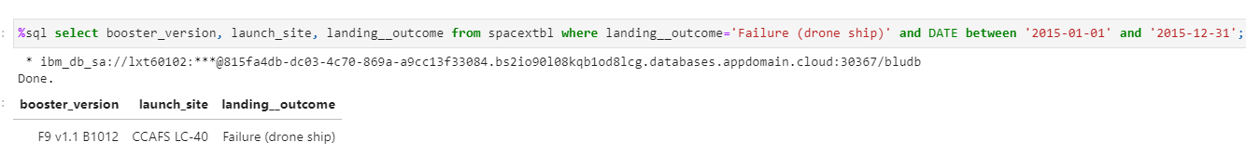
2015 Launch Records
Listed the records which will display the month names, failure landing outcomes in drone ship, booster versions, and launch site for the months in the year 2015.

Slide 32
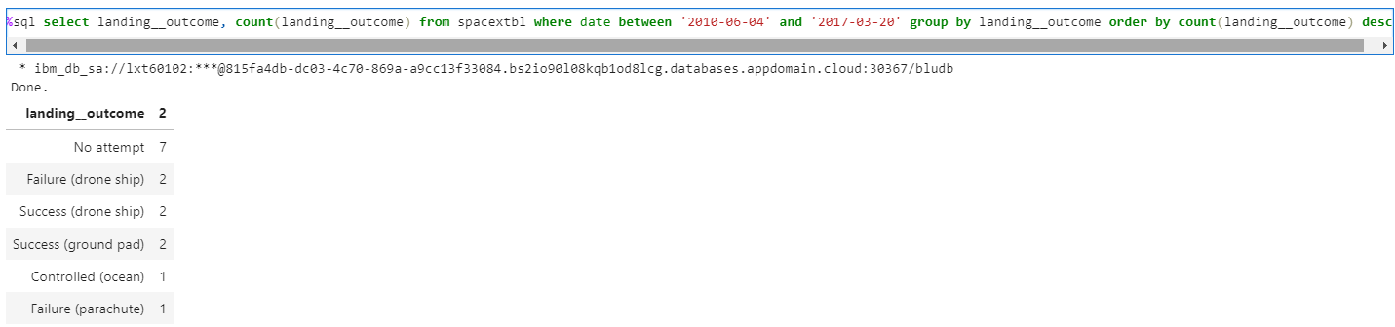
Rank Landing Outcomes Between 2010-06-04 and 2017-03-20
Ranked the count of successful landing outcomes between the above dates in descending order.

Slide 33

Section 3

Slide 34
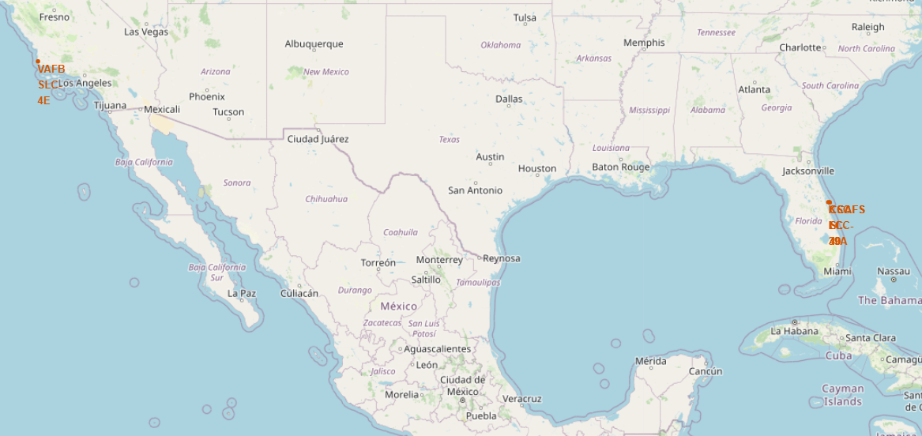
Space X Launch Sites

Slide 35
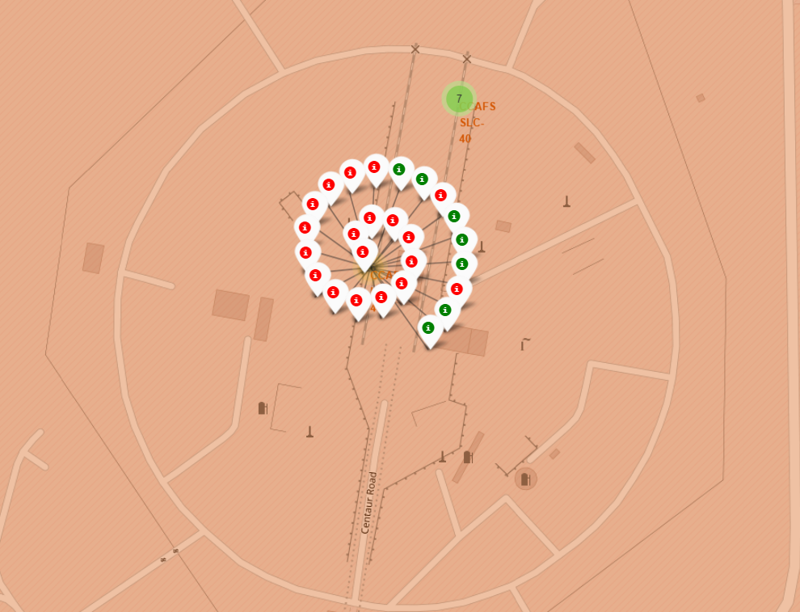
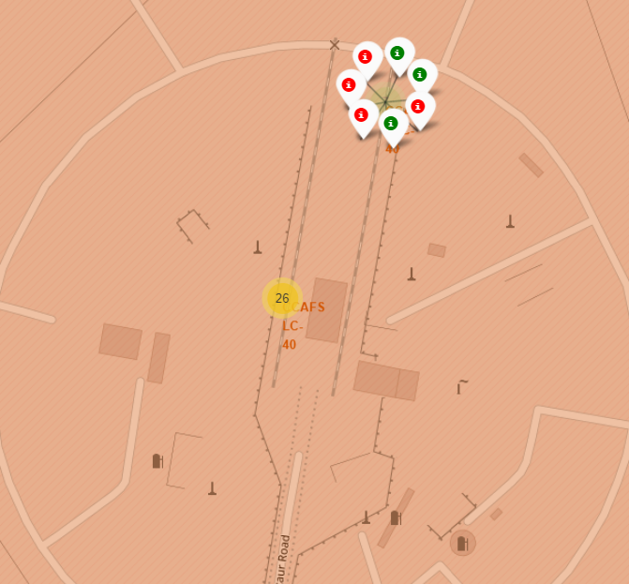
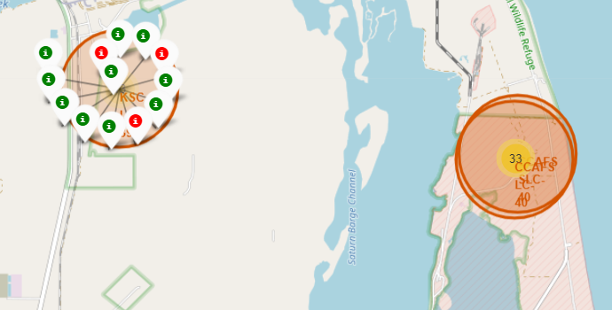
Markers Indicating Successful and Failed Launches
Red Colour = Fail
Green = Success

Slide 36
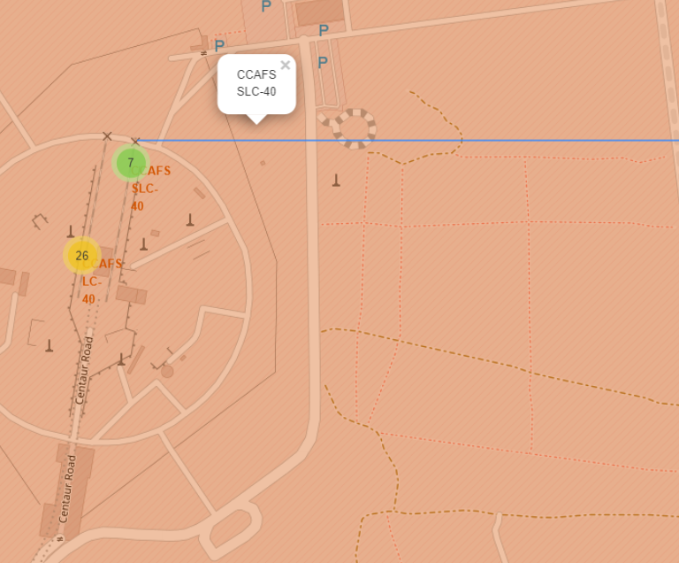
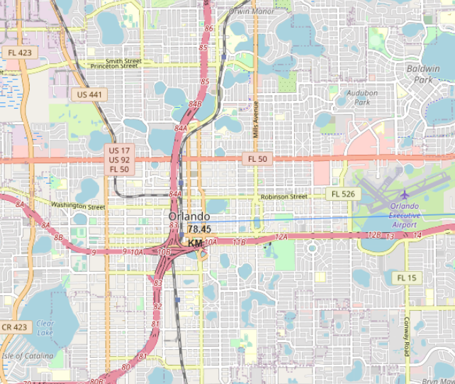
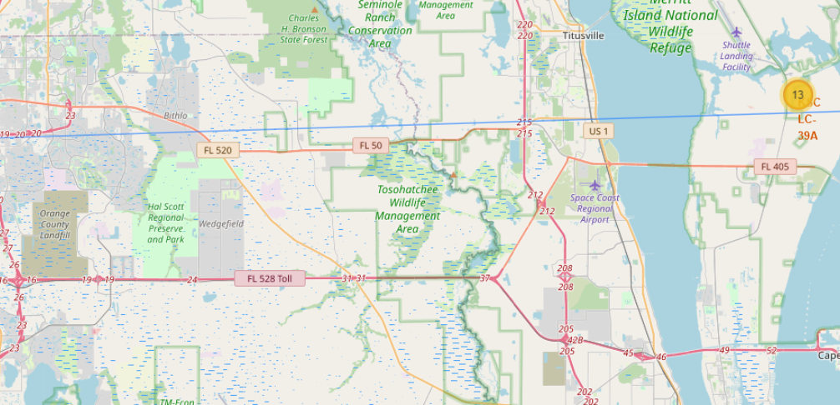
Launch Site Distance to Landmarks

Slide 37

Section 5

Slide 38
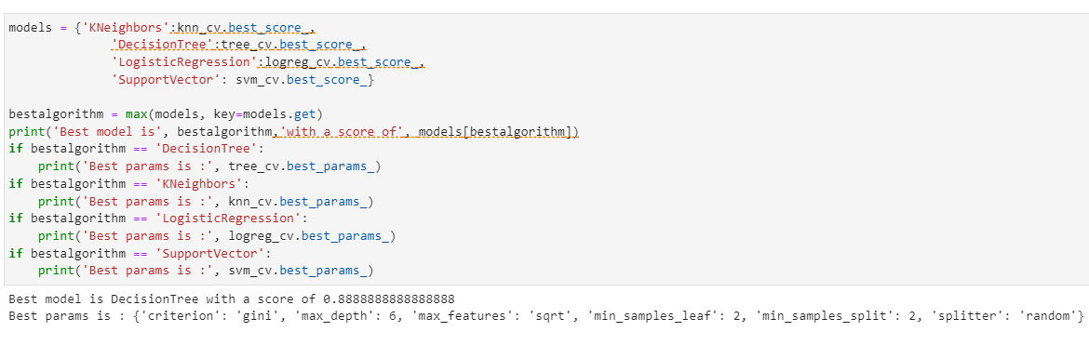
Classification Accuracy
The Decision Tree classification model had the best accuracy.

Slide 39
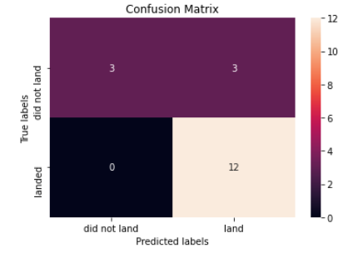
Confusion Matrix
The confusion matrix for the model shows that the classifier is able to separate the different classes.

Slide 40
Conclusions
The larger the flight amount at a launch site, the greater the success rate at a launch site.
Launch success rate started to increase from 2013 till 2020.
Orbits ES-L1, GEO, HEO, and SSO had the best success rate.
KSC LC-39A had the most successful launches of any launch site.
The Decision Tree classifier had the highest accuracy for predictions between the machine algorithms that were tested.

Slide 41
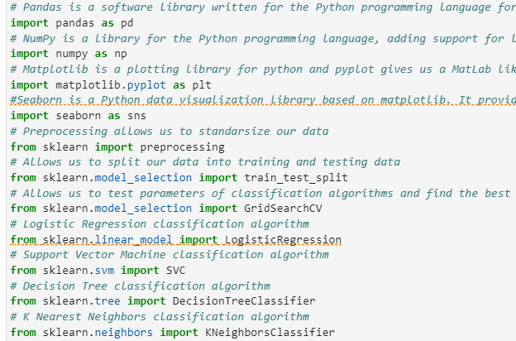
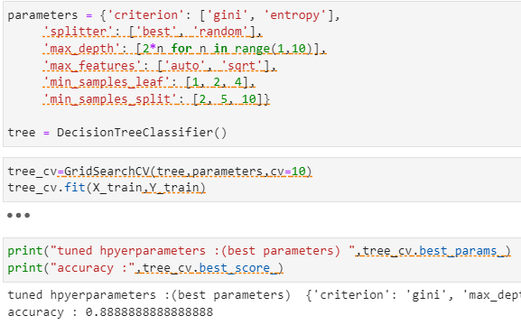
Appendix

Slide 42


